Slide 1
Movie Library App IMPLEMENTATION
Example Presentation for Advanced Mobile Computing Assessment 1.2
By: Harjinder Singh
Senior Lecturer – Computer Science
Date: 11/04/2020
Disclaimer: this is only an Example – NOT AN IDEAL SOLUTION!!
Notes:
Hi, My name is Harjinder Singh, I am a Senior Lecturer at BCU.
This is my (EXAMPLE) presentation for Assessment 1.2 – App Implementation – of the CMP7163 (Advanced Mobile Computing Module)
I will talk about my app in the following steps:
I will REVIEW my original Design Idea – presented for assessment 1.1 – and comment on what has CHANGED
I will describe the overall STRUCTURE of my completed App implementation
I will describe and DEMONSTRATE the User Interface
I will give examples of the CODE behind the UI
I will give examples of the CODE used for Data Persistence on-device
I will give examples of the CODE used for accessing a Web Service for cloud based data
I will give examples of the CODE used to implement an Additional Framework feature in my App
I will give a conclusion describing the SUCCESSES and CHALLENGES of this Implementation effort

Slide 2
Movie Library App Design - REVIEW
The aim was to design a Prototype Movie Library App for the Android and iOS platforms (cross-platform).
User is able to find information about movies, and save/view/delete their favourite movies on their device locally.
However, the user is not able to share information about their favourite movies directly from the App onto Social Media (e.g. Twitter). There were time issues in completing this feature.
Notes:
The implementation follows the proposed design fairly closely – although it is a limited prototype implementation.
All the core features for searching movies and managing favourites have been implemented as per the original design
However, the feature to share favourite movies over social media was not implemented.

Slide 3
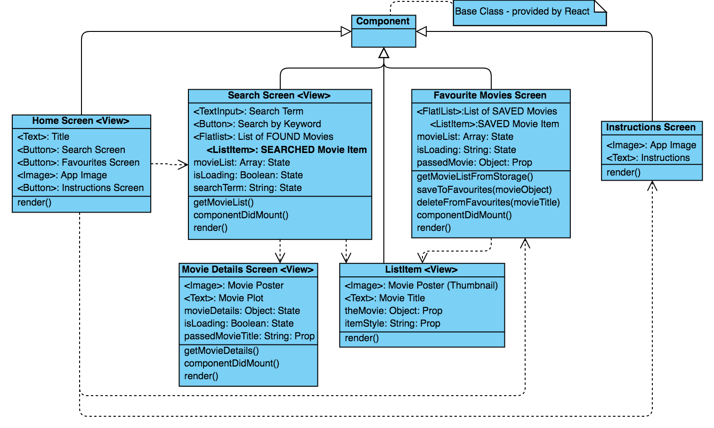
Overall App STRUCTURE
https://online.visual-paradigm.com/
Notes:
This slide describes the overall structure of the App:
There are 5 screens in the App – Home, Movie Search, Favourite Movies, Movie Details and App Use Instructions
The Search screen is a core screen in that it contains the feature that allows you to search for Movies (from OMDB) by a keyword (search term). It maintains state variable for a list of the movies, whether it is still loading, and the search term the user has entered. It displays the results in a Flatlist of movie items once data is retreived.
The Favourites screen is used to maintain selected movies in device memory as Favourites. It is rendered when a user selects a movie on the Search screen to be marked as favourite. This screen also maintains state variables for a movieList retrieved from AsyncStorage, and whether it is still loading. The movie whose details are to be loaded (from a second call to the OMDB service) is passed in from the previous (Search) screen. It can also be invoked directly from the Home screen to view all existing Favourites.
The ListItem is the custom component that was created for use by all the lists within this app. It receives the movie object and style (colour) to be displayed as thumbnail image and title.
The other screens (Home, Instructions) are for mainly for general display only.

Slide 4
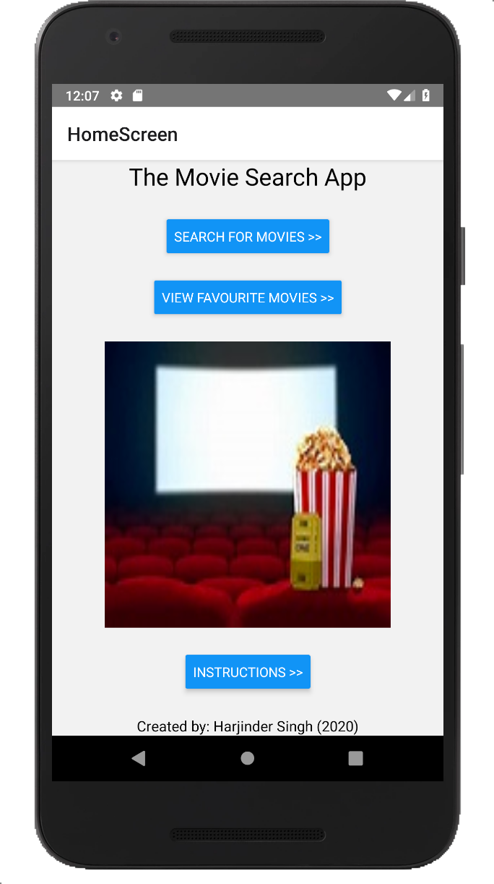
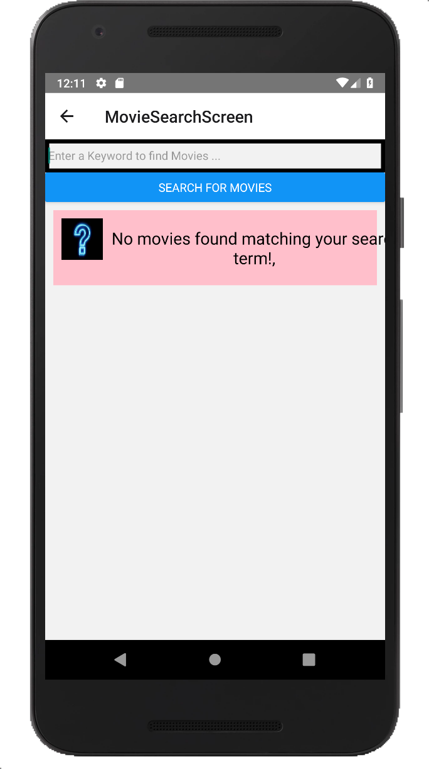
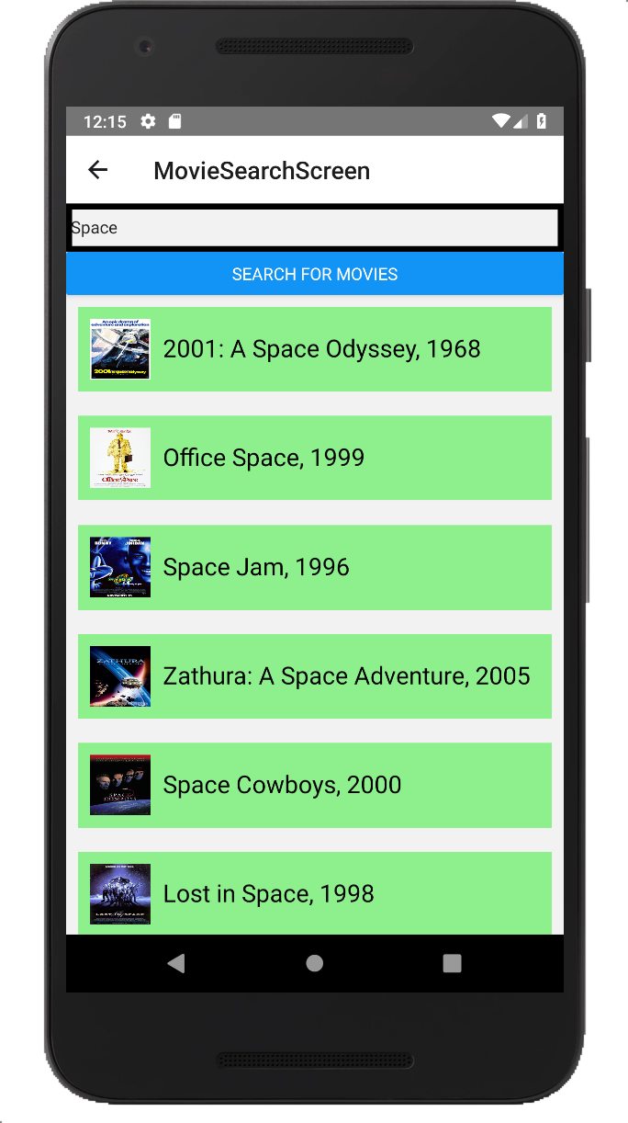
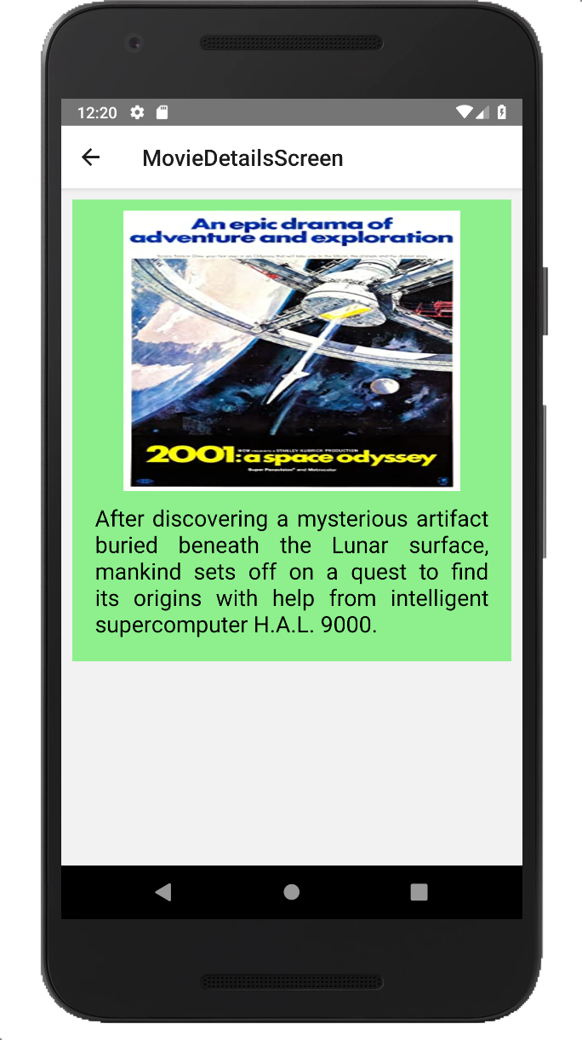
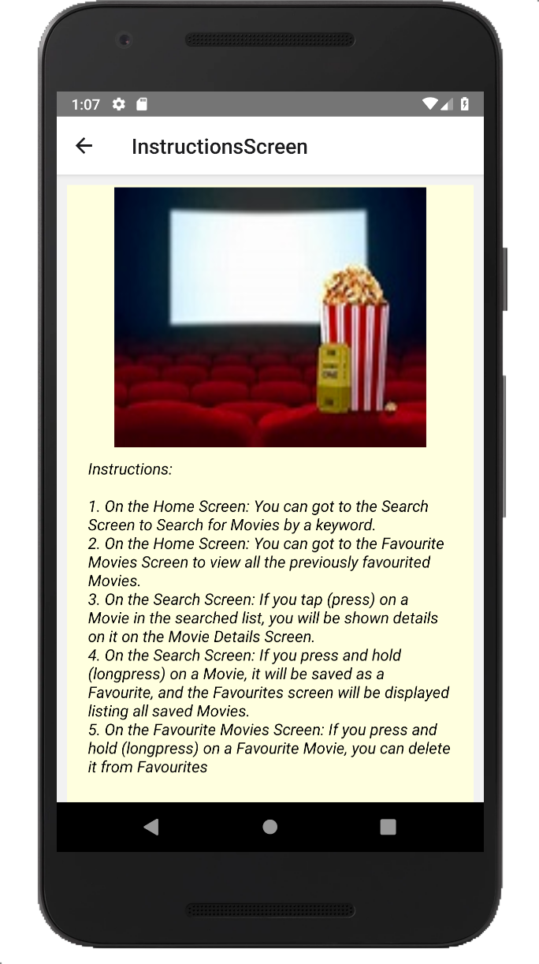
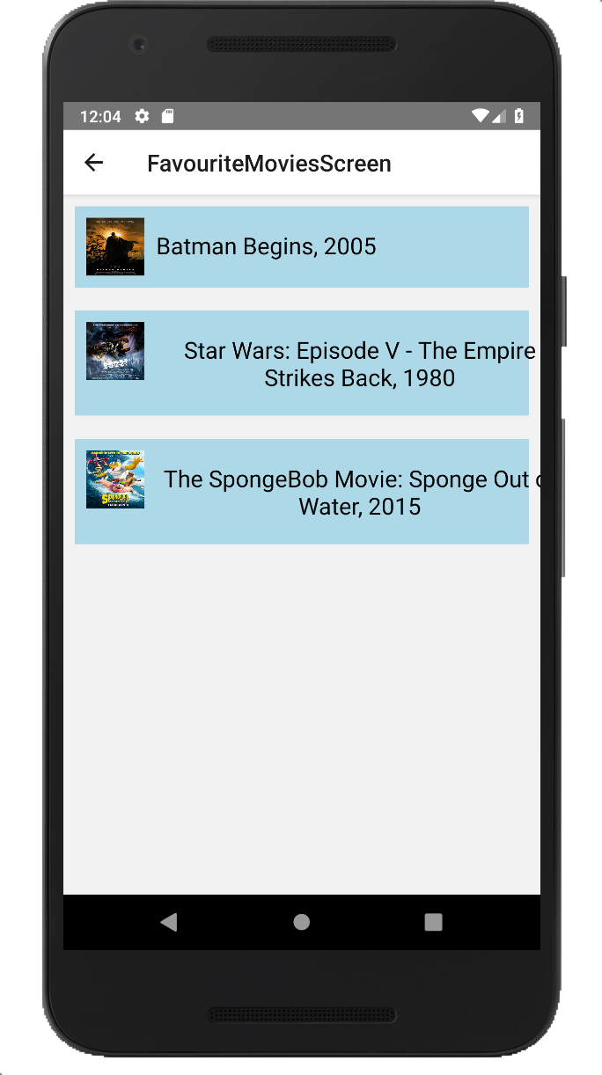
User Interface Implementation –UI Flow diagram
Enter Keyword to Search for Movies
Tap Movie to View Details
Press and hold Movie to Save and View Favourites
Notes:
As described on the previous slide, the main screens are displayed here:
The Home screen is the entry point of the app UI and has three buttons to navigate to the Search, Favourite and Instruction screens, respectively. It also displays the App title and logo image,
The Search screen starts with the list showing an empty movie list – by displaying a single ’dummy’ list item (pink). When the user enters a search term (keyword) and presses the search button (or taps the enter key) a search of the OMDB service is conducted and any returned movie data is parsed and displayed in the list (green). If there are no movies matching the search term found in the database – the empty item remains displayed.
If the user single taps on an item in the movie list on the Search screen, the Details screen appears showing further details about the item selected (it’s fullsize poster, and it’s plot).
If the user presses and holds down an item in the movie list on the Search screen, the Favourites screen appears showing the list of Favourites including the item selected.
On the Favourites screen, if a favourite movie item is pressed and held down, it will be removed from the Favourites (from saved data on device) and the display refreshed to reflect the change.
The Instructions screen simply display the textual instructions on how to use the App.
The Favourites screen can also be invoked directly from the Home screen, to display a list of the previously saved Favourites (the saved data on device)
All screens are built on the React Navigation system – so allow navigation back and forth between screens elegantly.

Slide 5
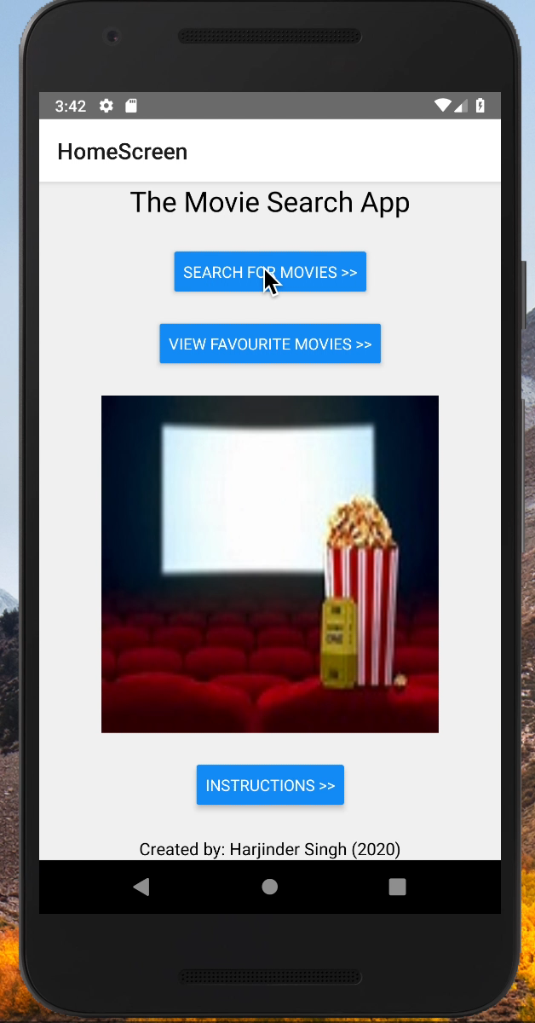
User Interface Implementation –UI Demo (video capture)
Notes:
This slide shows a brief video demonstration of the App in action. Press play on the popup menu that appears…

Slide 6
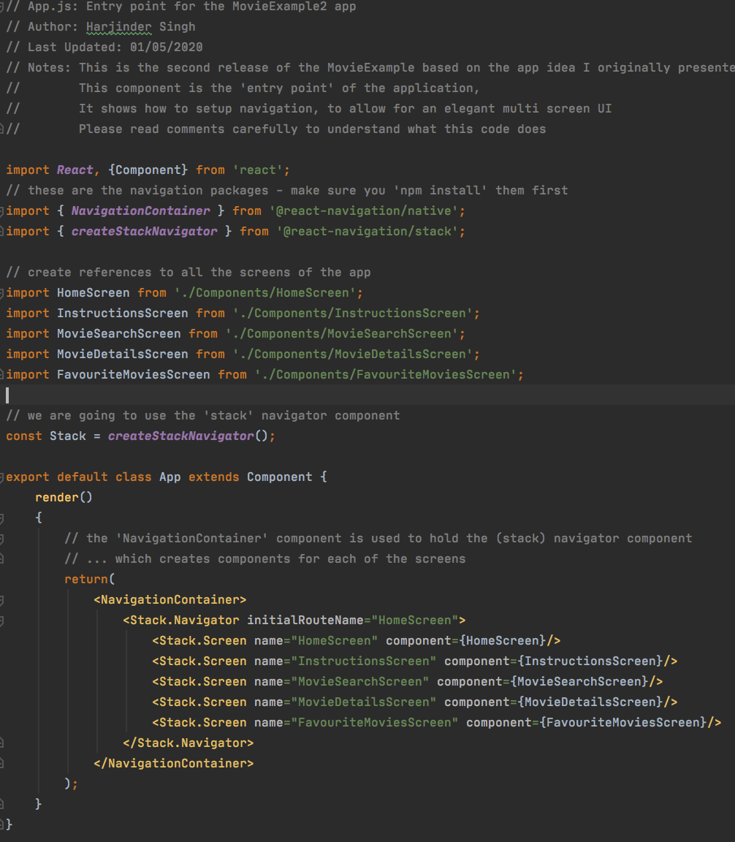
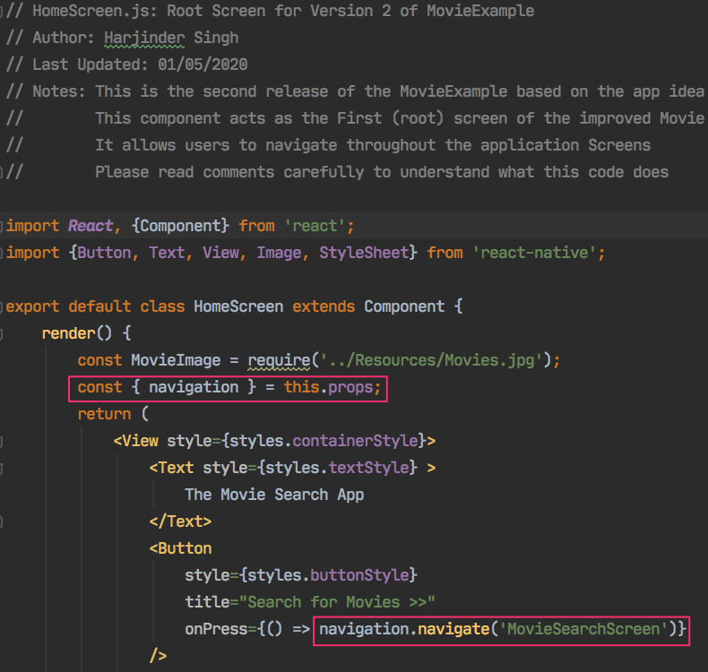
User Interface Implementation – Navigation Code examples
Notes:
As mentioned on the UI description slides, the App uses ‘react-navigation’ library to implement ‘stack’ type navigation between screens.
This is implemented in the App’s entry point - the App.js file.
The ‘createStackNavigator’ function generates the stack object, that is then used in the ‘NavigationContainer’ component to add screens to the stack.
It also indicates which screen is the startup screen of the App. Note that as all the screens are created as Components in separate JavaScript files – they need to be imported to this file.
If other screens need to access the navigation object, they must retrieve a reference to it through their props (all screens in the stack receive this prop).
This can be used to navigate further to other screens (as shown on the slide on the right – the Home screen navigating to the Search screen), or to access parameters passed between screens through the ‘route.params’ prop of navigation (see the other UI code slides later on).

Slide 7
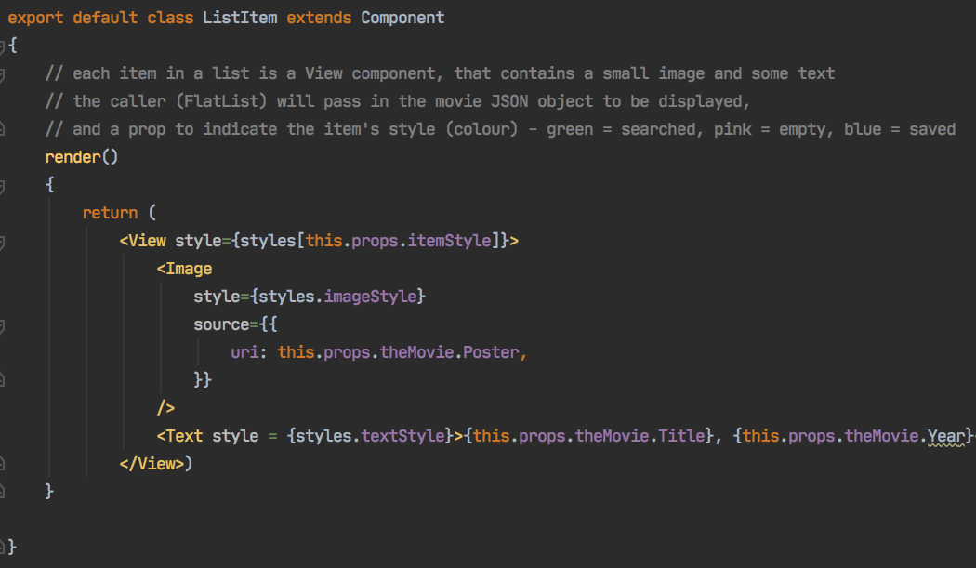
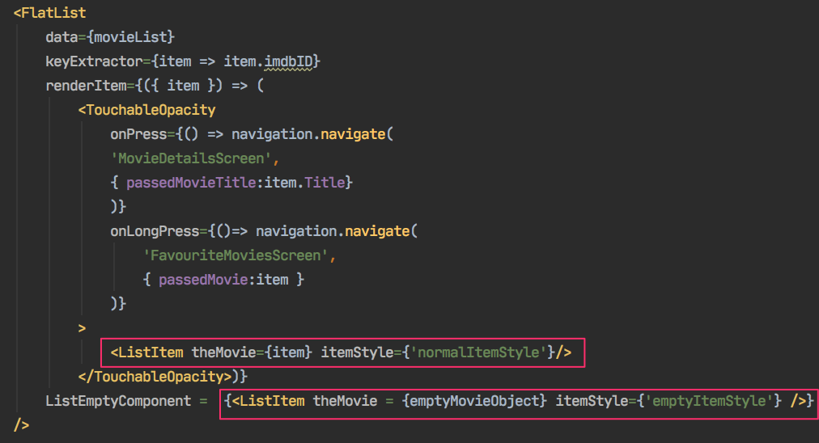
User Interface Implementation – Custom Component (ListItem) code example
Notes:
The ListItem component is a custom component that we have created to allow the movie items displayed in a list to be re-used throughout the App (in the Search and Favourite screens and for empty items).
It receives a movie / dummy object for it’s data and a style string for it’s display style (colour) – through its props.
The passed ‘theMovie’ prop is used to acquire the image from the movie’s ‘Poster’ key and the text from the movie’s ’Title’ key.
Similarly, the passed ‘itemStyle’ prop is used to select the display style (colour) of the list item from the styles defined in the ListItem.js file.

Slide 8
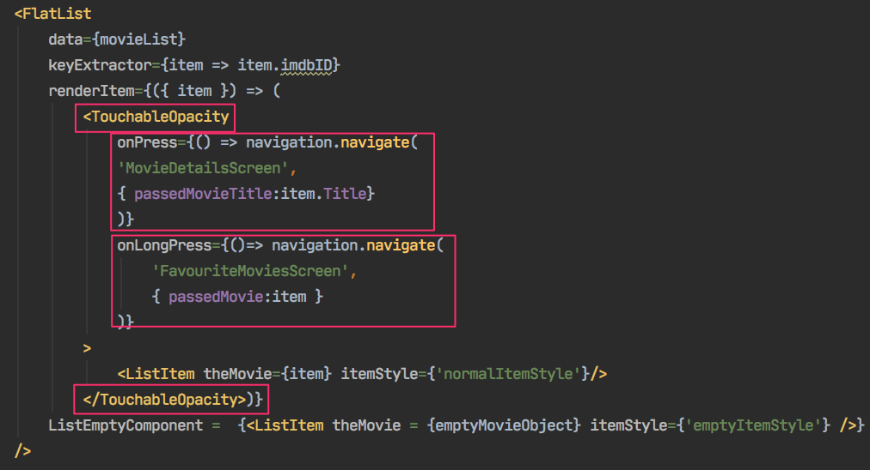
User Interface Implementation – Interaction / Event Handling code example
Notes:
There were many modes of user interaction implemented in this App, the main ones are:
Buttons on Home screen to navigate to other screens and on the Search screen to search the Web Service
The ’onPress’ prop of various componentis used to allow a ‘single tap’ interaction – e.g. to navigate from the Search to Details screen, or to capture the various Buttons being clicked
The ’onLongPress’ prop of various componentis used to allow a ‘tap and hold’ interaction – e.g. to navigate from the Search to Favourites screen, or to delete items from the Favourites screen
The ‘TouchableOpacity’ component is used to give components the ‘fading’ visual behavior – e.g. when a list item is selected

Slide 9
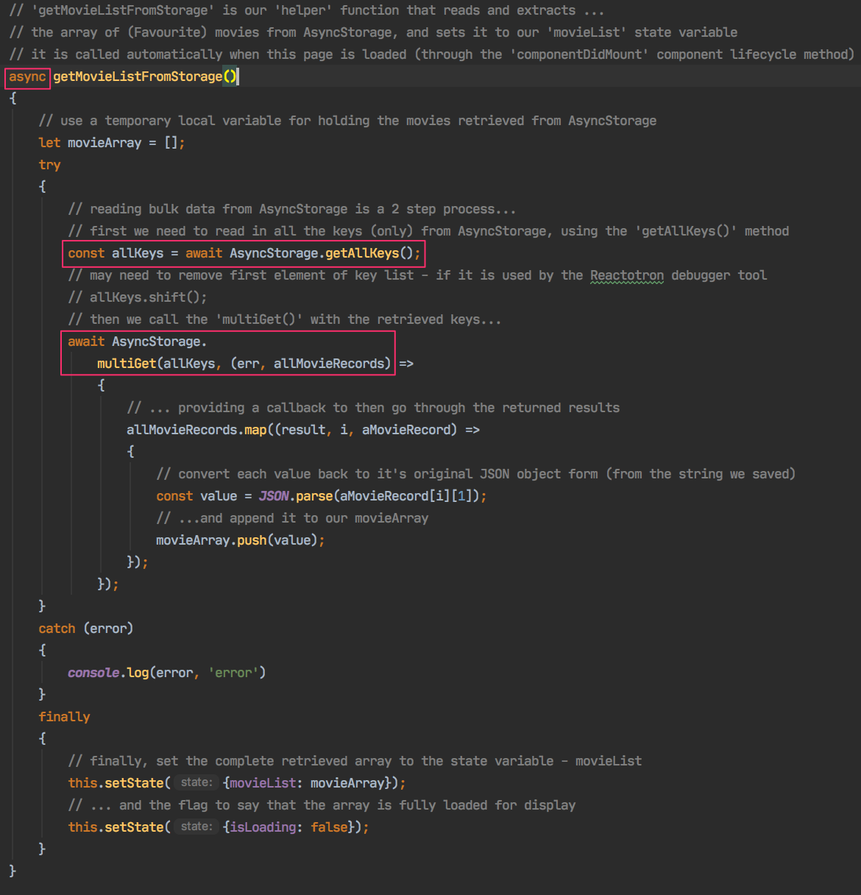
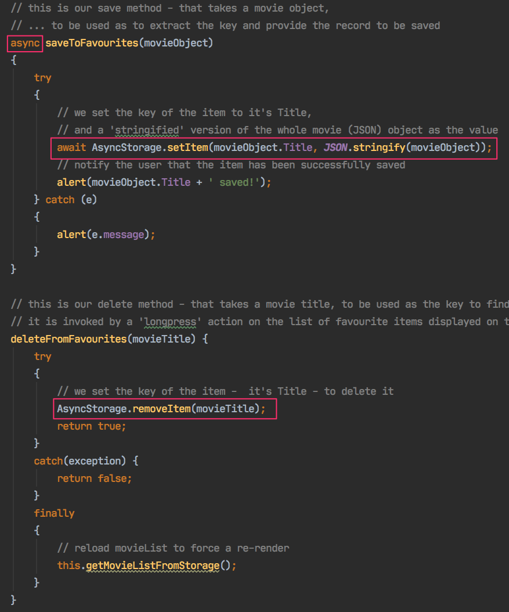
Data Persistence Implementation code examples
Notes:
The ‘AsyncStorage’ API of React Native was used to save, retrieve and delete movie objects in local on-device storage.
As it’s name indicates, it is an asynchronous mechanism (i.e. it run in parallel with other code) and this aspects has to be managed by our code - hence the ‘async’ and ‘await’ keywords.
To save a movie object – the ‘setItem’ method is used, passing it the Title of the movie as a Key and the movie object itself as the Value.
To delete a movie object – the ‘removeItem’ method is used, this time only the Key is needed to be passed (obviously)
To retrieve/read all the movies in storage – we need to use a two step process. First we call the ‘getAllKeys’ method, this gives us an array of all the Keys in storage. Then, we pass that array of Keys to the ‘multiGet’ method to retrieve all the movie records in storage. The records are returned as a 2 dimensional array of Key:Value pairs, we then need to iterate through the retrieved records to extract and oparate on the values as required.

Slide 10
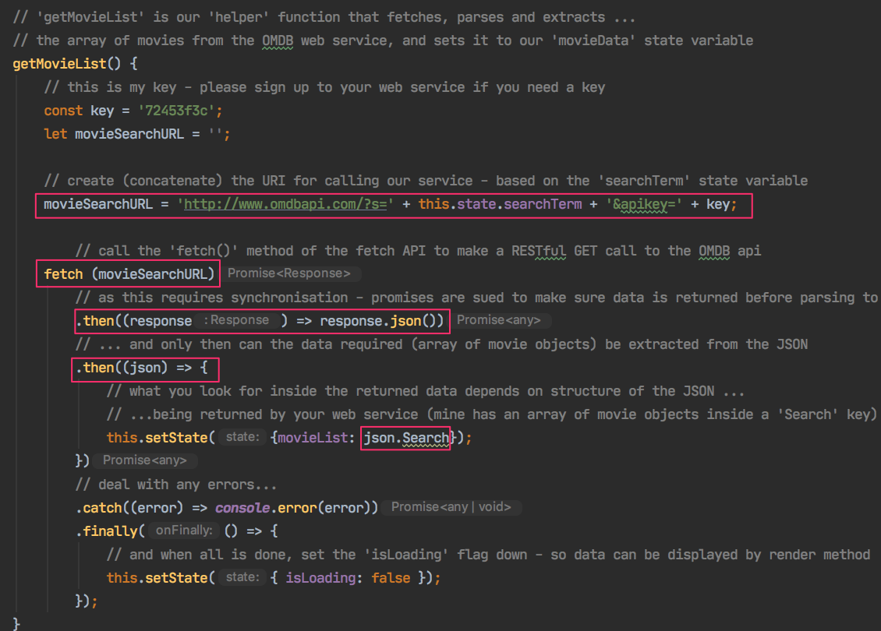
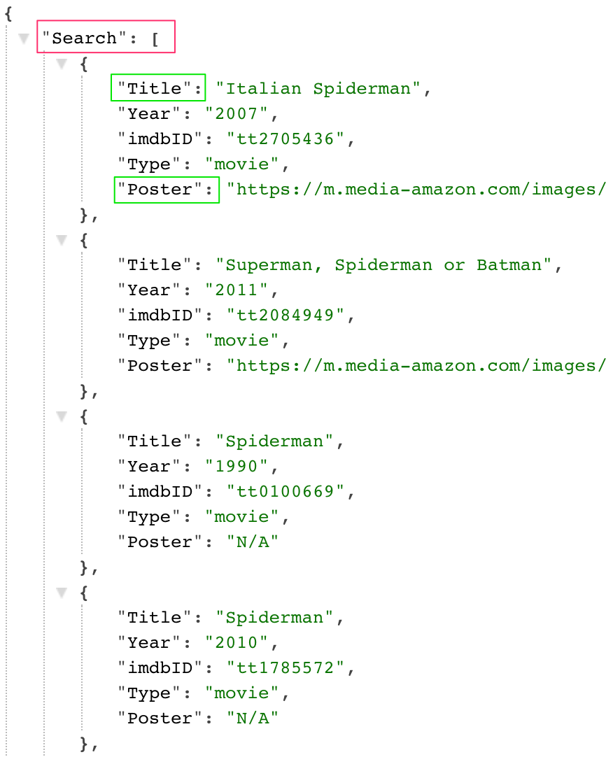
Web Services Implementation code example
Notes:
The React Native ‘Fetch’ API is used for accessing the public OMDB movie data Web Service in our App.
This is also an asynchronous API, so we need to deal with ’promises’ returned by calls – hence the ‘.then’ keywords (note: we could have also used ‘async’ / ‘await’ as before)
The ‘fetch()’ method accepts a URI as a String (which we construct based around the searchterm the user has entered in the example above (in the Search screen). It makes a GET call to the OMDB service.
The returned response (example given on the right of the slide) then needs to be parsed into proper JSON format.
Finally we can extract the key(s) we need from it (for OMDB searches – we need to extract the array of movies returned in the ‘Search’ key of the returned response (see example given).

Slide 11
Additional Frameworks / Features
Design specified to use Social Media (Tweet about favourite movies) but was not implemented…
Obviously – you should include your code examples for your additional framework features here to get the marks!!
Notes:
I didn’t plan to illustrate any additional framework (as you should all choose and implement your own!)

Slide 12
Conclusion and Challenges
Project successfully completed for the following features:
Created an easily navigable multi-screen UI
Able to read and parse data successfully from OMDB web service
Able to persist data on-device successfully.
Project challenged on following aspects:
Not able to modify cloud / web service data as it was accessed from a public service
Not able to add any additional frameworks due to time limitation
Some aspects of UI could be improved in terms of look-and-feel
Notes:
Finally, it can be said that a successful prototype was built based on the original design. The slide above describes the features that have been successfully implemented and which features were challenging or could have been improved.
Thank you!!
Any Questions?....

